Slide 1
Numerical Integration

Slide 2
Lecture’s Goals
Trapezoidal Rule
Simpson’s Rule
  1/3 Rule
  3/8 Rule
Midpoint
Basic Numerical Integration

Slide 3
Basic Numerical Integration
We want to find integration of functions of various forms of the equation known as the Newton Cotes integration formulas.

Slide 4
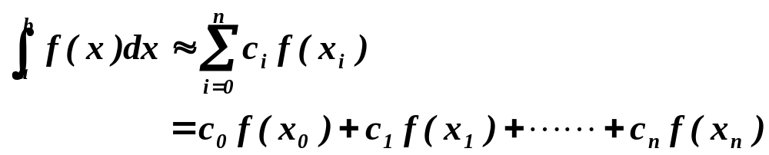
Basic Numerical Integration
Weighted sum of function values
f(x)
x₀
x₁
x_{n-1}
x_{n}
x

Slide 5
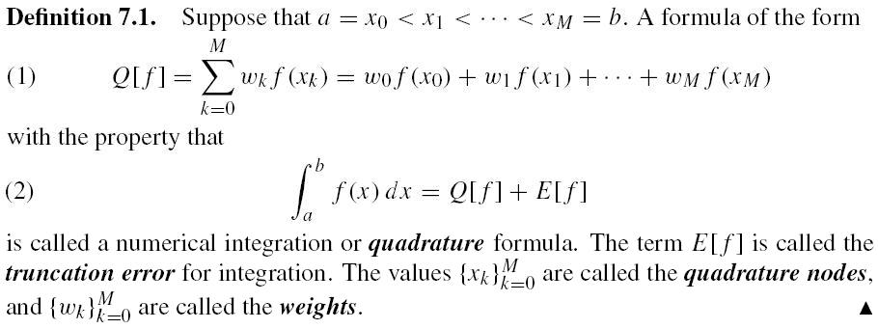
Page 353

Slide 6
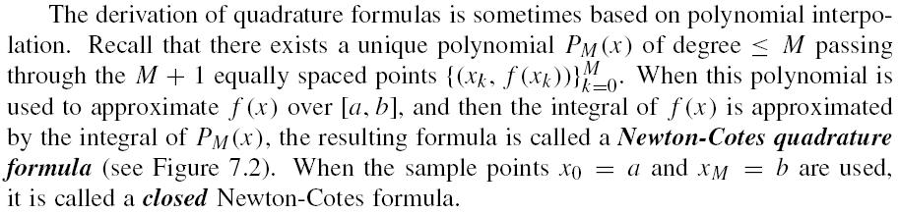
Page 354

Slide 7
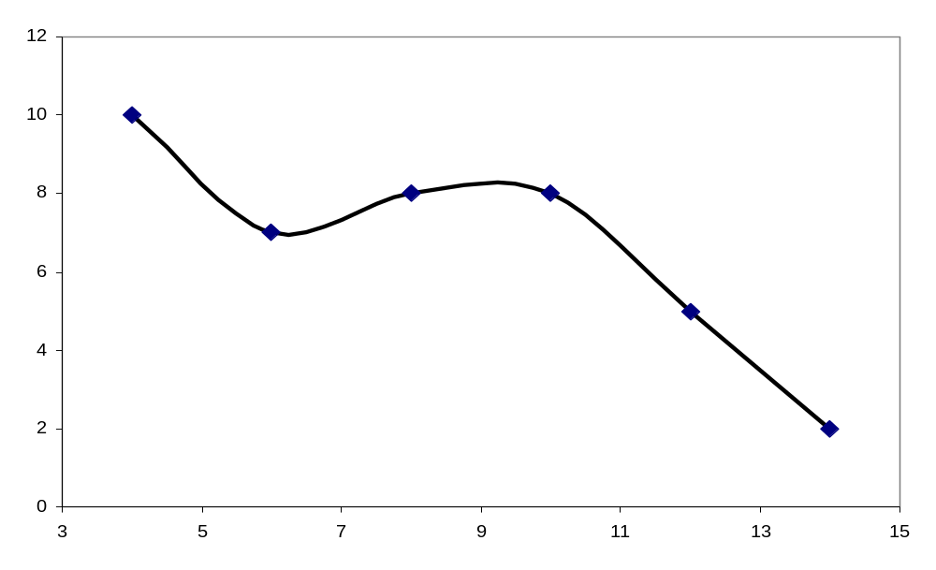
Numerical Integration
Idea is to do integral in small parts, like the way you first learned integration - a summation
Numerical methods just try to make it faster and more accurate

Slide 8
Numerical Integration
Newton-Cotes Closed Formulae -- Use both end points
  Trapezoidal Rule : Linear
  Simpson’s 1/3-Rule : Quadratic
  Simpson’s 3/8-Rule : Cubic
  Boole’s Rule : Fourth-order
Newton-Cotes Open Formulae -- Use only interior points
  midpoint rule

Slide 9
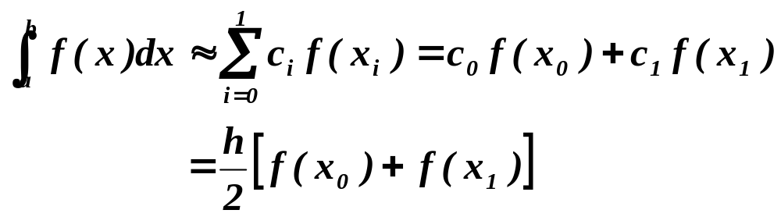
Trapezoid Rule
Straight-line approximation
f(x)
L(x)
x₀
x₁
x

Slide 10
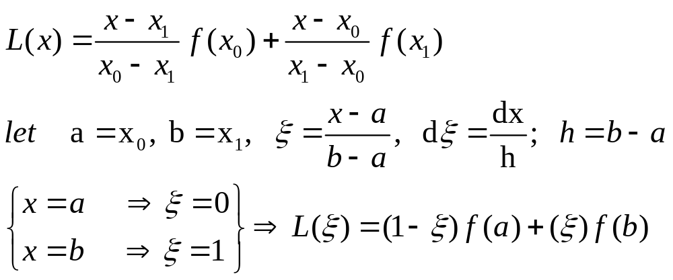
Trapezoid Rule
Lagrange interpolation

Slide 11
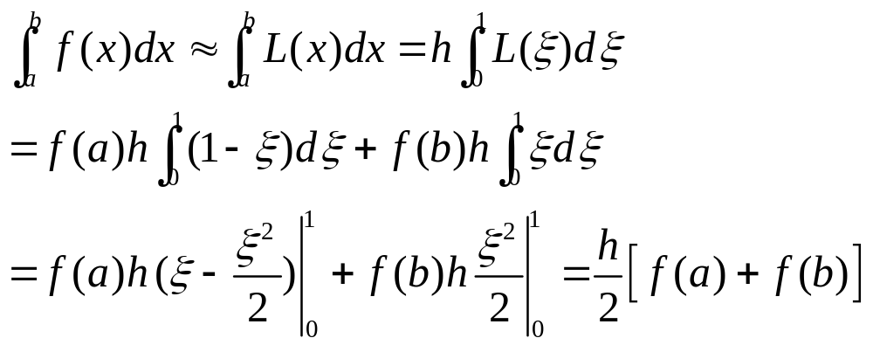
Trapezoid Rule
Integrate to obtain the rule

Slide 12
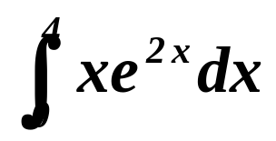
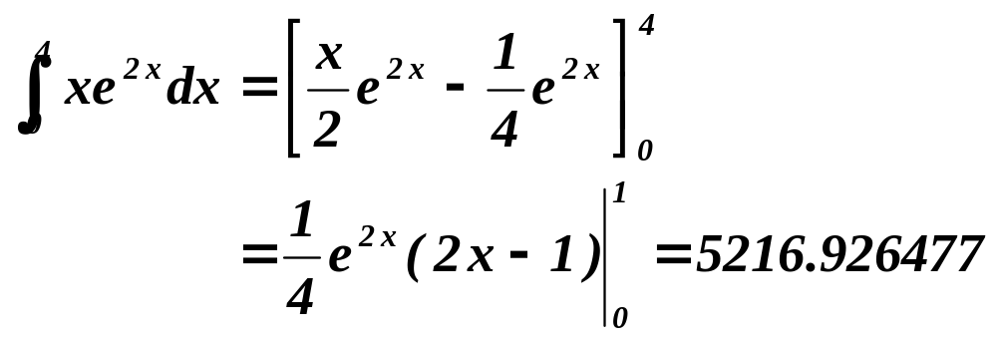
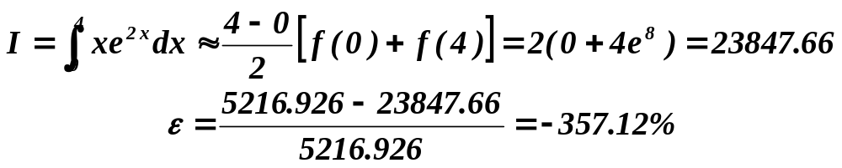
Example:Trapezoid Rule
Evaluate the integral
Exact solution
Trapezoidal Rule

Slide 13
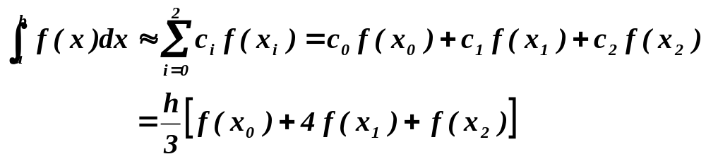
Simpson’s 1/3-Rule
Approximate the function by a parabola
L(x)
f(x)
x₀
h
x₁
h
x₂
x

Slide 14
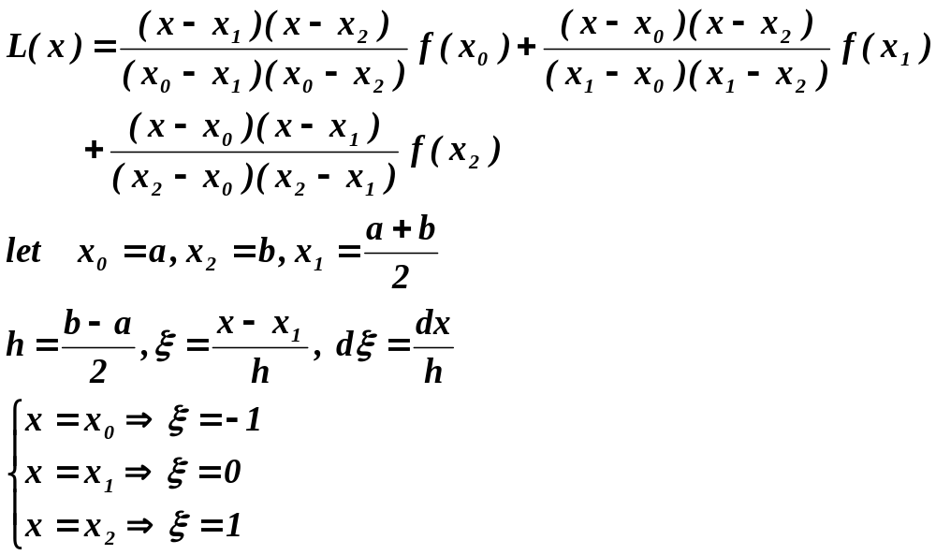
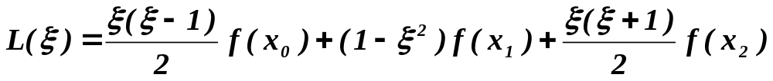
Simpson’s 1/3-Rule

Slide 15
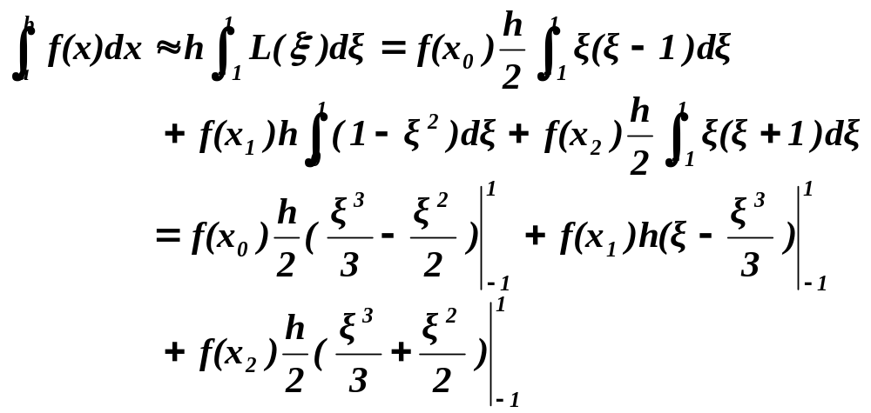
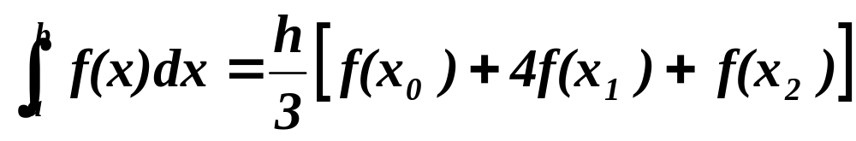
Simpson’s 1/3-Rule
Integrate the Lagrange interpolation

Slide 16
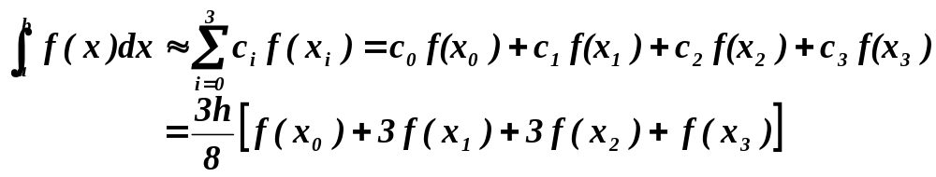
Simpson’s 3/8-Rule
Approximate by a cubic polynomial
L(x)
f(x)
x₀
h
x₁
h
x₂
h
x₃
x

Slide 17
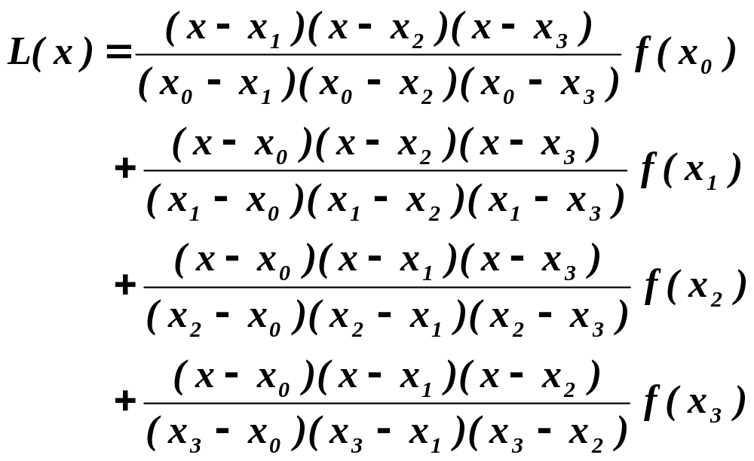
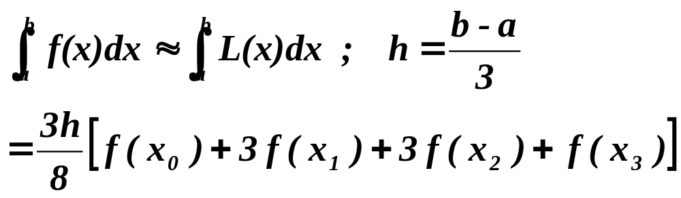
Simpson’s 3/8-Rule

Slide 18
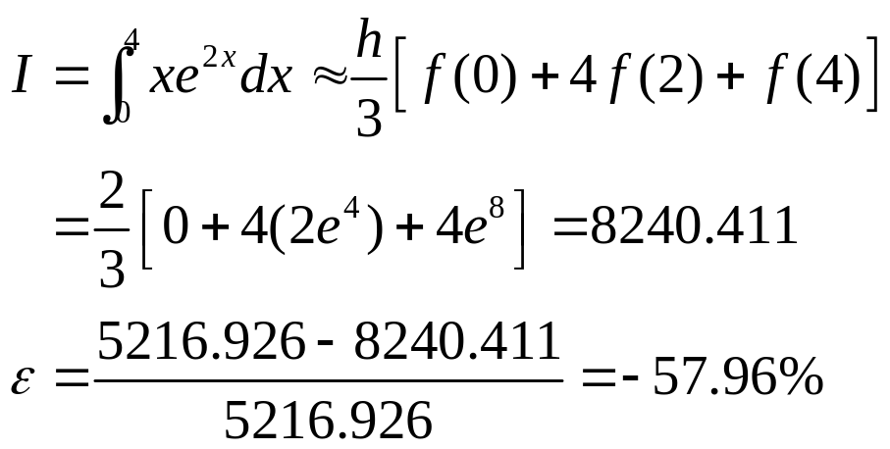
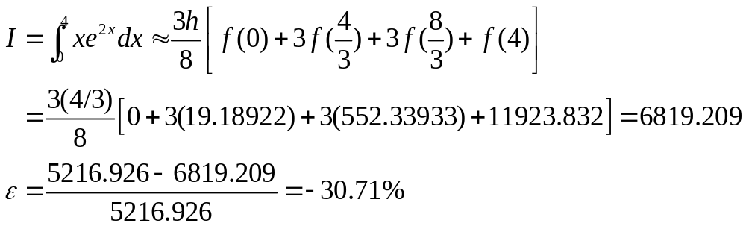
Example: Simpson’s Rules
Evaluate the integral
Simpson’s 1/3-Rule
Simpson’s 3/8-Rule

Slide 19
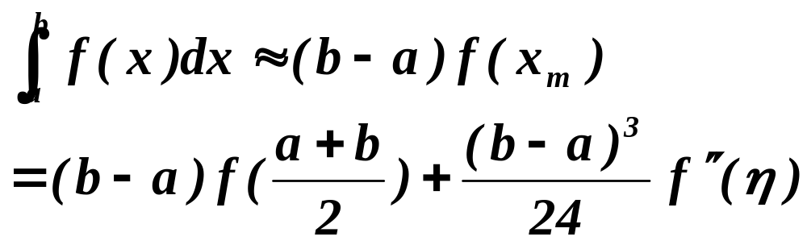
Midpoint Rule
Newton-Cotes Open Formula
f(x)
a
x_{m}
b
x

Slide 20
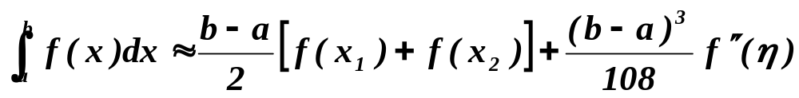
Two-point Newton-Cotes Open Formula
Approximate by a straight line
f(x)
x₀
h
x₁
h
x₂
h
x₃
x

Slide 21
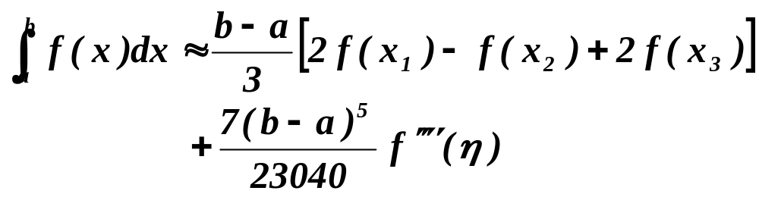
Three-point Newton-Cotes Open Formula
Approximate by a parabola
f(x)
x₀
h
x₁
h
x₂
h
x₃
h
x₄
x

Slide 22
Better Numerical Integration
Composite integration
  Composite Trapezoidal Rule
  Composite Simpson’s Rule
Richardson Extrapolation
Romberg integration

Slide 23
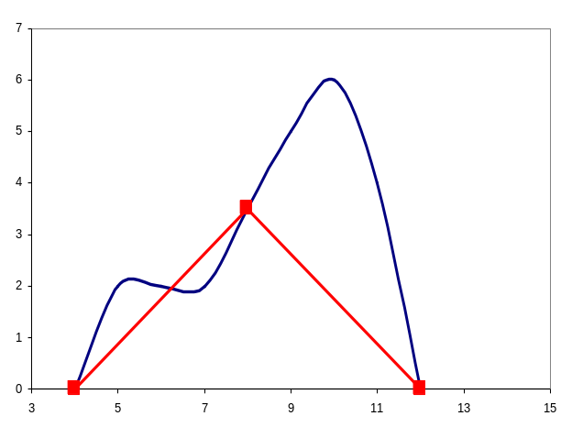
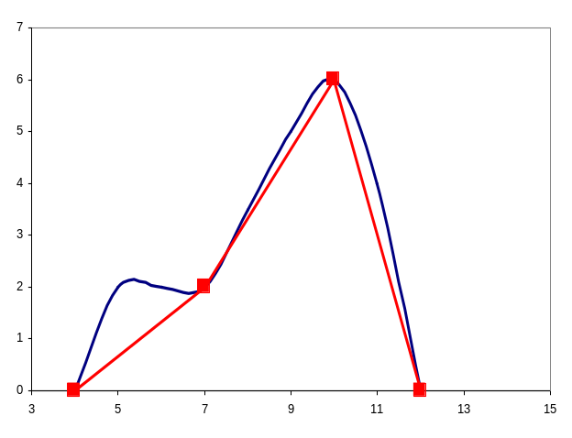
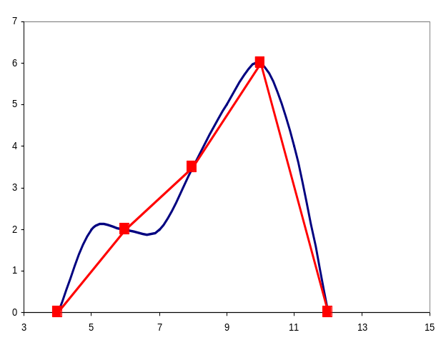
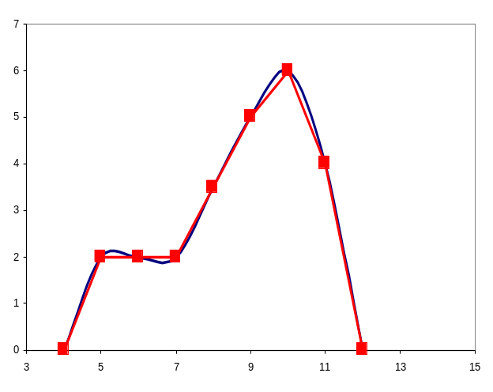
Apply trapezoid rule to multiple segments over integration limits
Two segments
Three segments
Four segments
Many segments

Slide 24
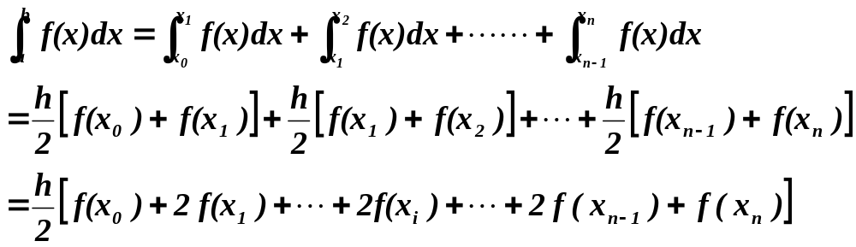
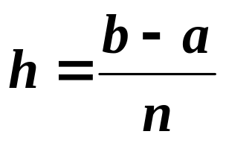
Composite Trapezoid Rule
f(x)
x₀
h
x₁
h
x₂
h
x₃
h
x₄
x

Slide 25
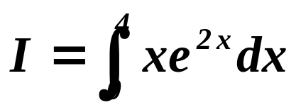
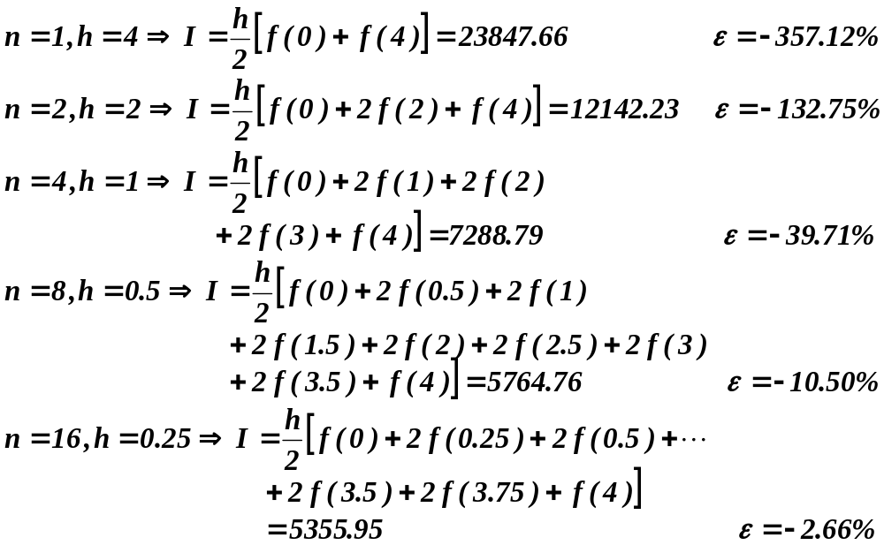
Composite Trapezoid Rule
Evaluate the integral

Slide 26
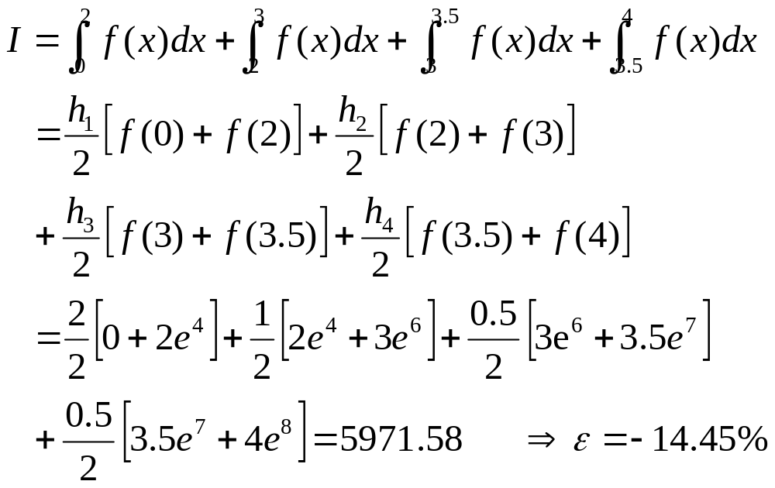
Composite Trapezoid Rule with Unequal Segments
Evaluate the integral
h₁ = 2, h₂ = 1, h₃ = 0.5, h₄ = 0.5

Slide 27
Composite Simpson’s Rule
Piecewise Quadratic approximations
f(x)
…...
x₀
h
x₁
x
h
x₂
h
x₃
h
x₄
x_{n-2}
x_{n-1}
x_{n}

Slide 28
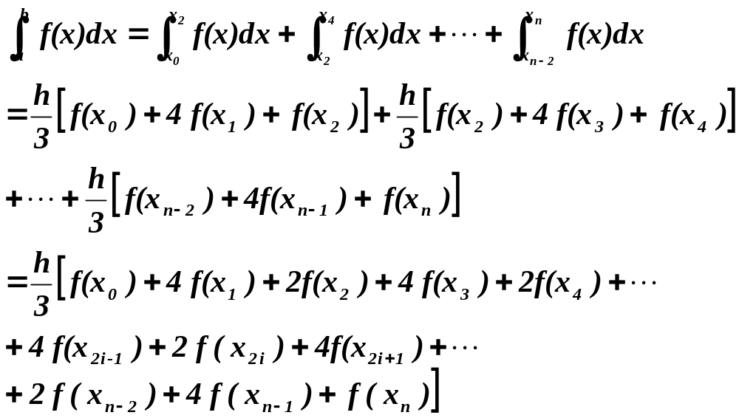
Composite Simpson’s Rule
Multiple applications of Simpson’s rule

Slide 29
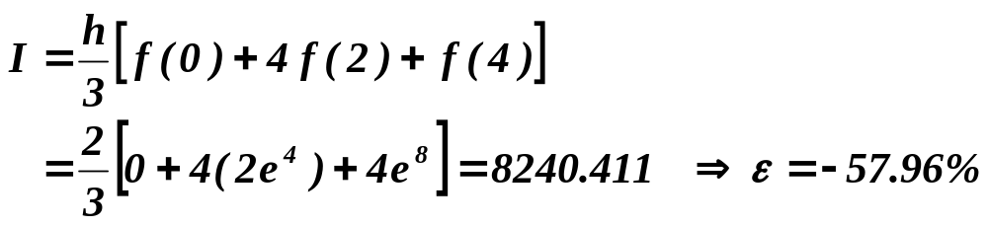
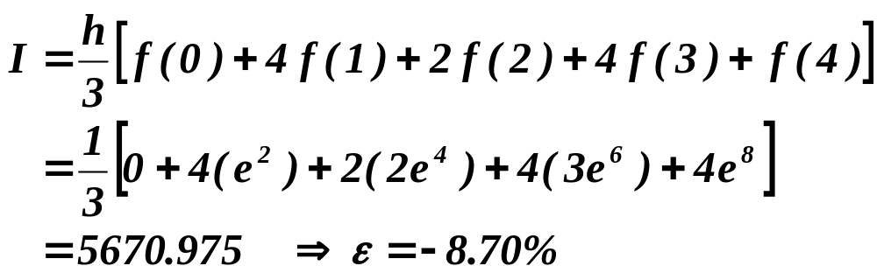
Composite Simpson’s Rule
Evaluate the integral
n = 2, h = 2
n = 4, h = 1

Slide 30
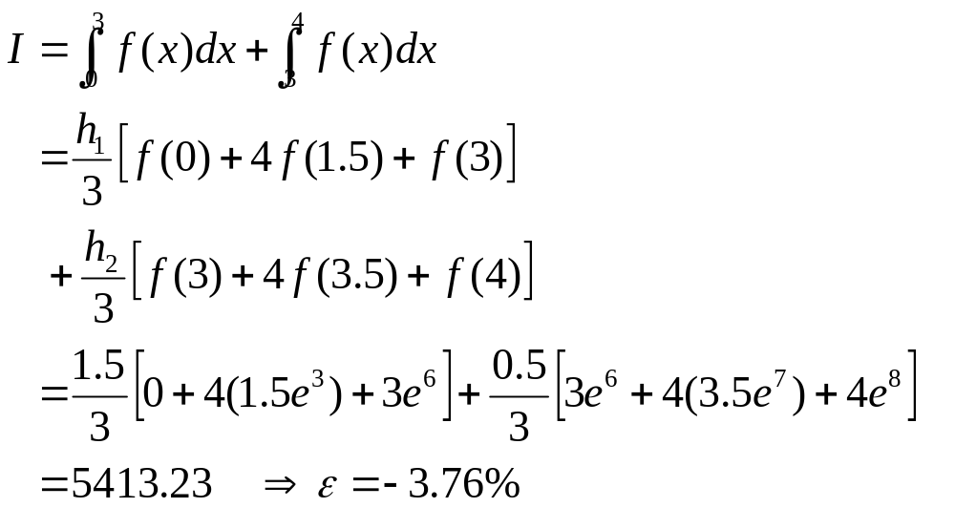
Composite Simpson’s Rule with Unequal Segments
Evaluate the integral
h₁ = 1.5, h₂ = 0.5

Slide 31
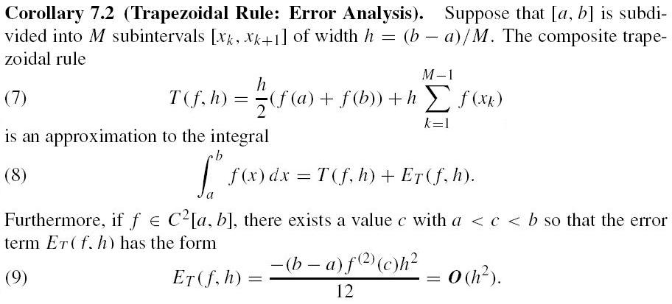
Error Analysis (P368)

Slide 32
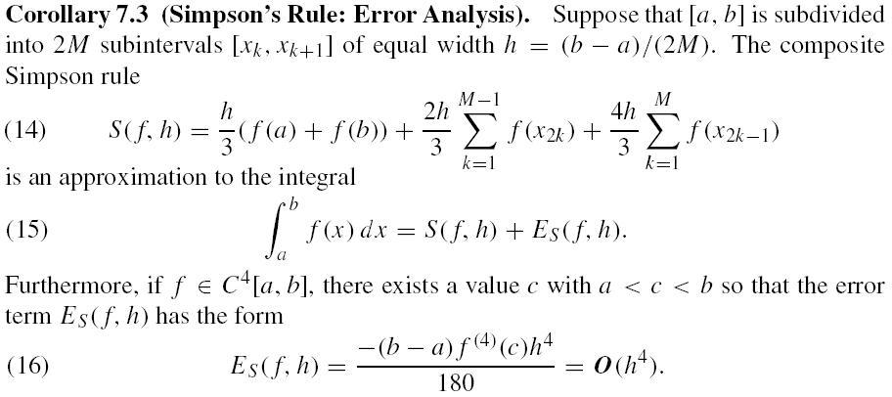
Error Analysis (P369)

Slide 33
Reading
Page 369 – Examples 7.7 and 7.8
Page 370 – Examples 7.9 and 7.10

Slide 34
Home Assignment
Page 362 – Exercises 1(a) and 2(a)
Pages 374 through 376 –
Exercises 1(a), 8(a), 9(a), 10 and 11.

Slide 35
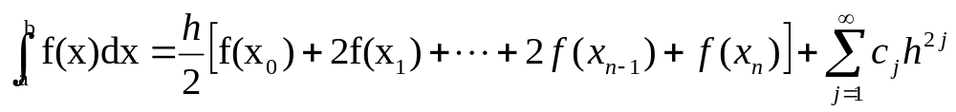
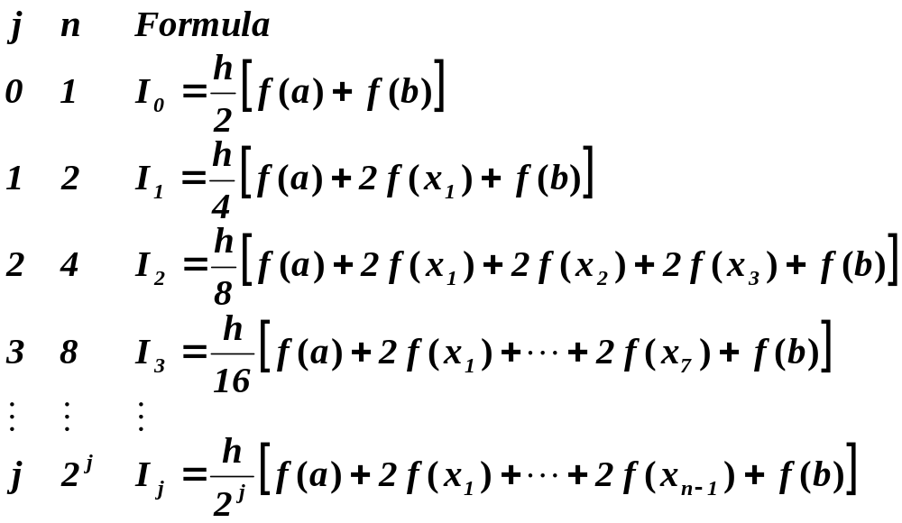
Richardson Extrapolation
Use trapezoidal rule as an example
  subintervals: n = 2^{j} = 1, 2, 4, 8, 16, ….

Slide 36
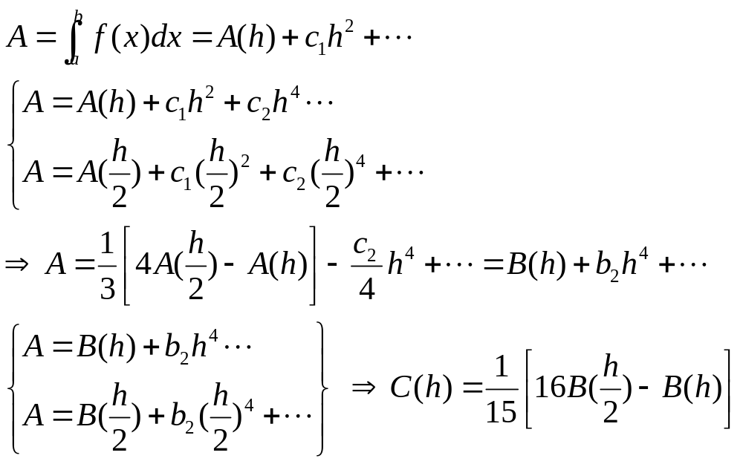
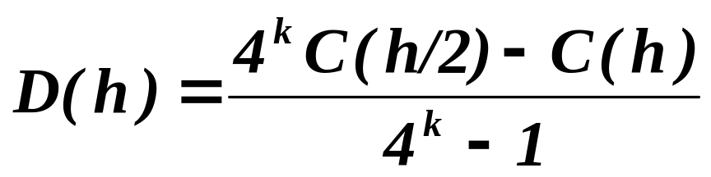
Richardson Extrapolation
For trapezoidal rule
  k^{th} level of extrapolation

Slide 37
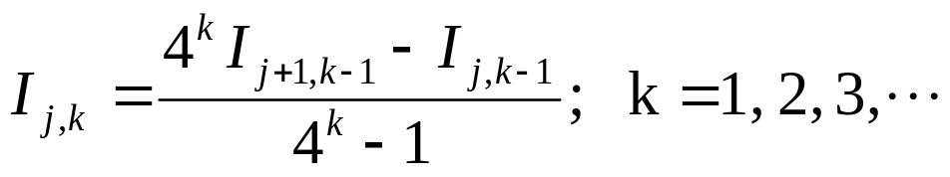
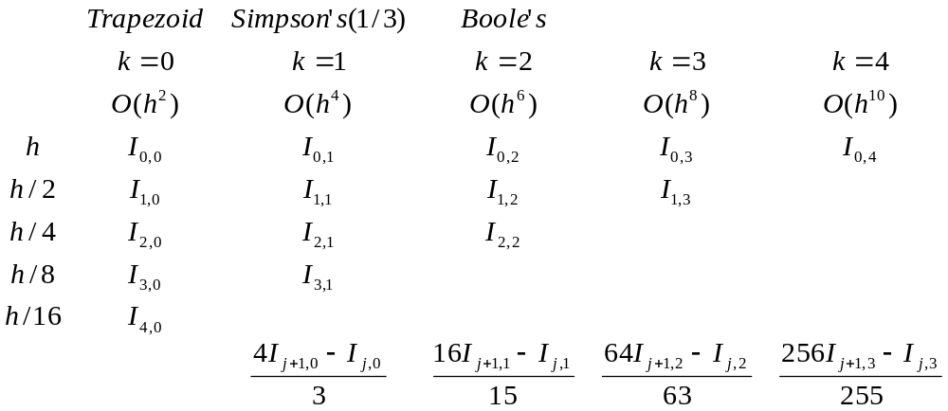
Romberg Integration
Accelerated Trapezoid Rule

Slide 38
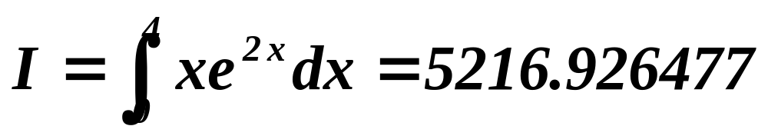
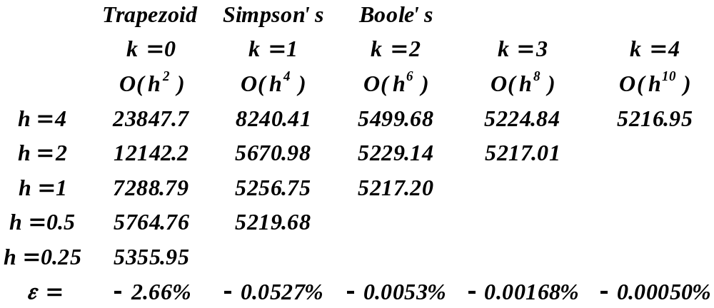
Romberg Integration
Accelerated Trapezoid Rule

Slide 39
One more example (P386)
Page 386 – Example 7.14
Home Assignment
Page 389 – Exercise 1(a)(c)
Notes:
>> di=(256*2.038197427064-2.038197426156)/255
di =
2.0382
>> format long
>> di=(256*2.038197427064-2.038197426156)/255
di =
2.038197427067561
>> gao=(256*2.038197426156-2.038197162776)/255
gao =
2.038197427188863
>> (256*4*di-gao)/(256*4-1)
ans =
2.038197427067442
>>

Slide 40
Summary
Integration Techniques
  Trapezoidal Rule : Linear
  Simpson’s 1/3-Rule : Quadratic
  Simpson’s 3/8-Rule : Cubic
  Boole’s Rule : Fourth-order

Slide 41
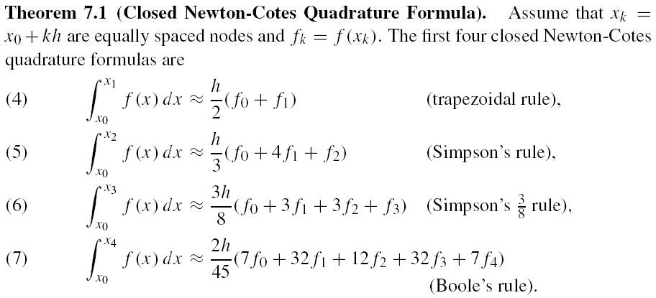
Summary (P354)

